Slide 1
Breast cancer histology image classification using CNN
Team Members:
Ch. Prudhvi Sairam (B160555CS)
J. Vishnu Vardhan Sai (B160733CS)
G. Hemanth Nath Chowdary (B160747CS)

Slide 2
Problem Statement
To develop a convolutional neural network model with good accuracy score to classify the H&E stained breast histology microscopic images in to four classes:
NORMAL , BENIGN, IN-SITU carcinoma and INVASIVE carcinoma classes.

Slide 3
Literature survey
Aditya golatkar et al proposed a patch level classifier with Inception v3 architecture. They have achieved a classification accuracy of 79% at patch level. They have done image level classification accuracy of 85% using majority voting

Slide 4
Densenet201
In standard cnn, input image goes through multiple convolution and obtain high level features.
DenseNet, each layer obtains additional inputs from all preceding layers and passes on its own feature-maps to all subsequent layers. Concatenation is used. Each layer is receiving a “collective knowledge” from all preceding layers.
Since each layer receives feature maps from all preceding layers, network can be thinner and compact, i.e. number of channels can be fewer. So, it has higher computational efficiency and memory efficiency.

Slide 5
Dataset Description
The dataset consists of HE stained breast histology microscopy images in four classes: normal, benign,in situ carcinoma and invasive carcinoma.
The dataset contains a total of 400 microscopy images, distributed equally among all the classes.
Microscopy images have the following specifications:
Color model:R(ed)G(reen)B(lue)
Size:2048 x 1536 pixels

Slide 6
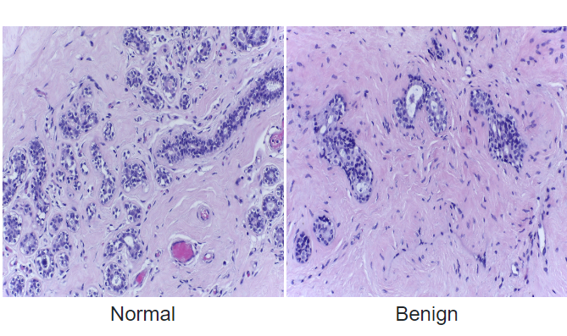
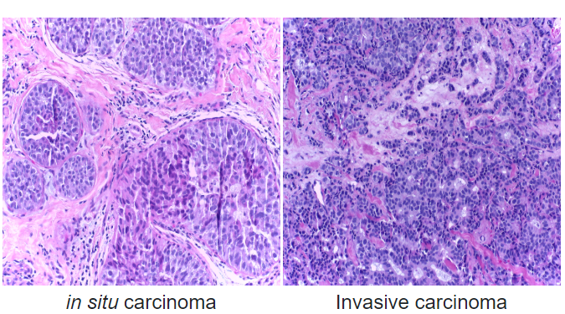

Slide 7
Design
Design consists of three steps:
Data Pre-processing
Training
Classification

Slide 8
Data Preprocessing
In data preprocessing we apply following techniques:
COLOUR NORMALIZATION:
Stain inconsistency in histology images will affect the performance of image analysis.
To reduce the stain inconsistency we will use colour normalization.[3]
We will use the method proposed by Reinhard which transforms the RGB images to the L*a*b* color space, followed by utilizing the means and standard deviations for each channel separately in L*a*b* colour space and finally, converts the results back to RGB.[3]

Slide 9
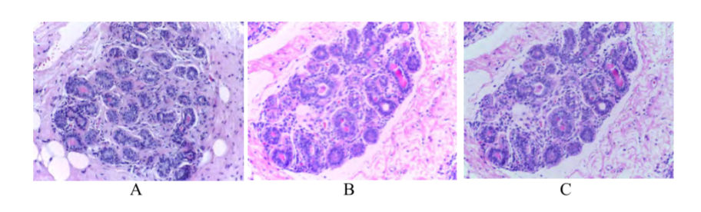
a
Target image (B) Original image (C) Image after normalization

Slide 10
Division of images into patches
If we train a cnn model with our dataset without doing any resizing or dividing it into patches, we may loose nuclei level information and tissue level information.[4]
Due to loss of information, accuracy will be decreased.
So, we will divide the patches into different sizes and extracted patches are given the same label as the corresponding histology image.

Slide 11
Data Augmentation
This preprocessing is mainly used to increase the input dataset images.
we will apply data augmentation to each patch by either rotating or flipping the patch at different angles.
After applying the data augmentation, each patch will be transformed into more patches.

Slide 12
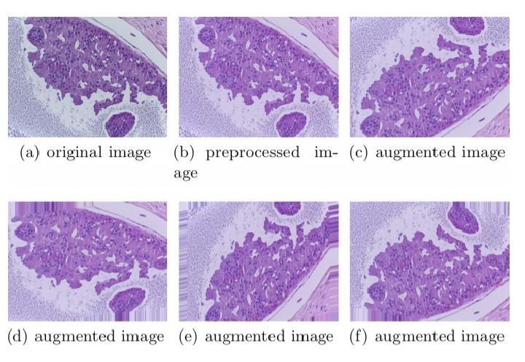

Slide 13
Resizing the patches
Each cnn architecture is pretrained with a set of images of some fixed size of either (299*299 or 224*224)
As our dataset contains patches of different size, we have to resize the patches into the size that fits the cnn architecture.

Slide 14
Training
After applying the different pre-processing techniques, we will train three models using the patches obtained from the pre-processing stage using transfer learning.
We will train the three models using three different cnn architectures
1.RESNET 52
2.DENSENET 169
3.DENSENET 201

Slide 15
Classification
PATCH WISE CLASSIFICATION:
In patch wise classification, each stain normalized microscopy image is divided into patches.These patches are augmented and resized according to the CNN architecture.
Now,these patches are classified using model trained using the training data.

Slide 16
IMAGE WISE CLASSIFICATION:
We combined the patch-based predictions using majority voting to determine the class of the entire image.
Now again we will use majority voting to determine the label of the image based on the predictions of three models trained during the training stage.[1]

Slide 17
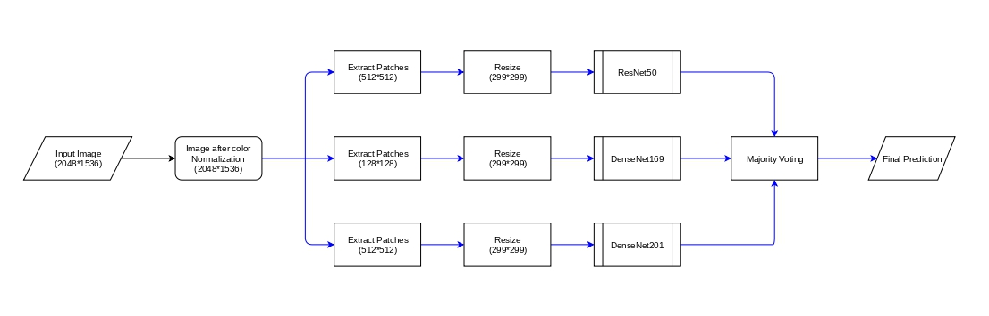

Slide 18
Work done
We downloaded dataset from ICIAR 2018.
We split data into training data (80%) and Validation data(20%) and we have a seperate set of 100 Images for testing.
We built 3 models of different CNN architectures without any preprocessing techniques but just by resize large image to size of 299*299 using fastai deep learning library on google colaboratory

Slide 19
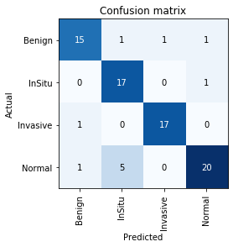

RESNET 50
Input Imagesize : 299*299
Accuracy : 80% (On Test Dataset)
Epochs : 60 (Unfreeze) + 60 (freeze)

Slide 20


DENSENET 169
Input Imagesize : 299*299
Accuracy : 81%
Epochs : 60 (Unfreeze) + 60 (freeze)

Slide 21
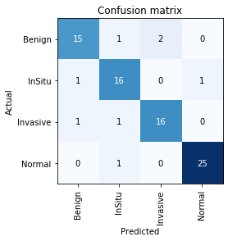

DENSENET 201
Input Imagesize : 299*299
Accuracy : 88%
Epochs : 60 (Unfreeze) + 60 (freeze)

Slide 22
Applying preprocessing techniques
We applied colour normalization for the original data.We used Reinhard normalization technique[3] for this.
We used staintools package in python for doing the tissue-image stain normalization.
Also we used SPAMS(SPArse modelling software) toolbox which is used for various estimation problems.

Slide 23
Images after normalization

Slide 24
PATCH WISE DIVISION
We divided the images into patches.[4]
Each image is divided into 35 patches.
Each patch is of size 512px*512px and we applied a stride of 256px for dividing the image into patches.
After dividing the 400 images into patches, we got 14000 patches. Out of which 10500 are used for training and remaining 3500 for validation.

Slide 25
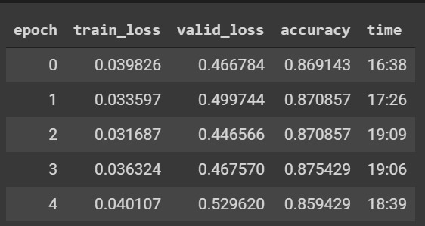
After applying colour normalization and dividing the images into patches, we trained DENSENET-201 model on this patches.
We trained the DENSENET-201 model upto 10 epochs.

Slide 26
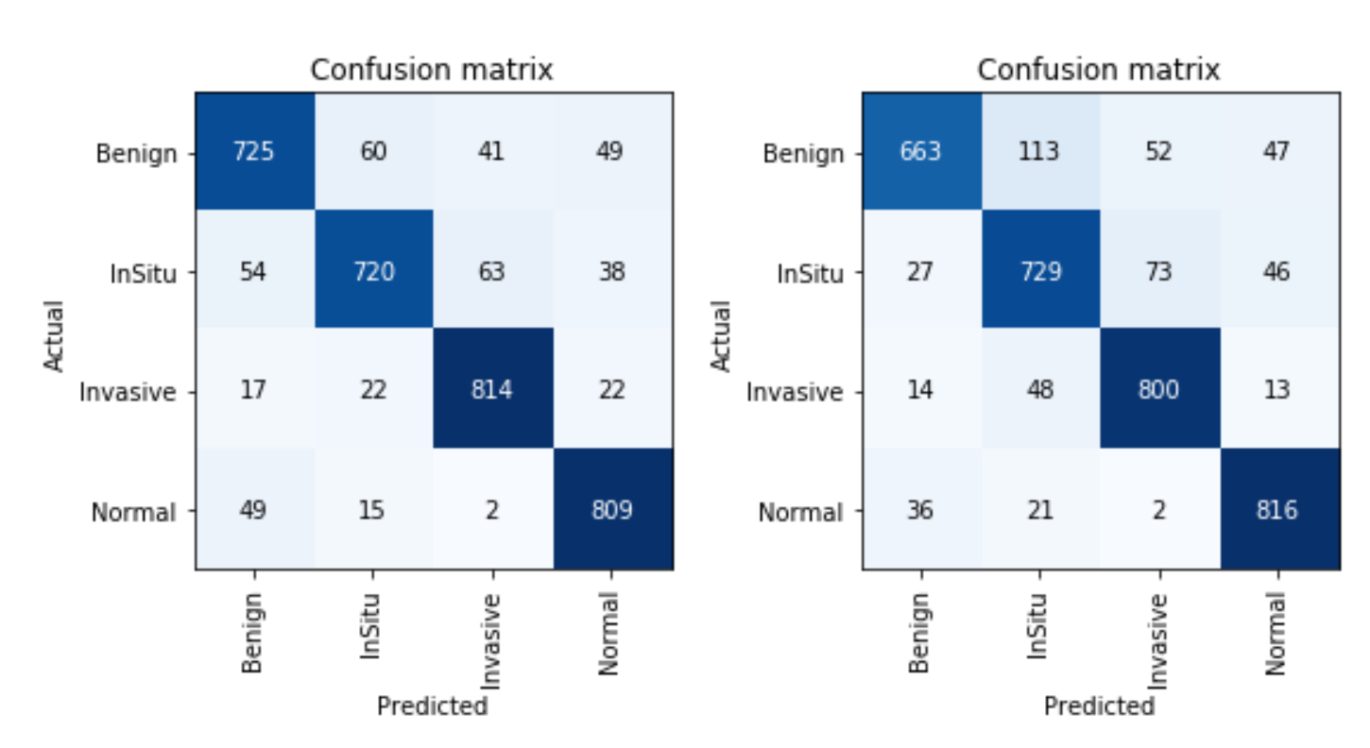

Slide 27
The accuracy on test dataset was around 81%.
The accuracy has not increased as expected as we have trained the model for very less number of epochs.
We also need to remove some of the patches which doesn’t contain any information about nuclues.
We should consider only nuclei concentrated patches.

Slide 28
Conclusion
We have trained DenseNet201 model on patches divided from original images and trained up too 10 epochs.we got an accuracy of 81%.
We have got many patches which doesn’t contain any information about nuclei which could deviate the result of test images due to majority voting scheme based on patches.

Slide 29
Conclusion
In the past, where the doctors need to perorm the classification of the histology images has been huge time consuming task and also the after this manual task was around 75%.
Convolution neural networks has made this task automated with a classification accuracy better than the accuracy achieved by manual task. We trained three cnn models using Densenet201 architecture and performed majority voting on these three models. We got accuracy of 88% for the classification.
We can further increase this accuracy by applying different preprocessing techniques like data augmentation, which can make the manual work of classification by doctors fully automated and much easier.

Slide 30
Work to be done
Training the Patch wise classification even more epochs.
Using image processing technique to remove confusing data in patches and select nuclei concentrated patches for training.
Generalizing model even further by using more data obtained from data augmentation

Slide 31
References
1.Aditya Golatkar, Deepak Anand, and Amit Sethi Classification of Breast Cancer Histology using Deep Learning.
2.Araújo, Teresa et al. “Classification of breast cancer histology images using Convolutional Neural Networks.” PloS one vol. 12,6 e0177544. 1 Jun. 2017, doi:10.1371/journal.pone.0177544
3.A Non-Linear Mapping Approach to Stain Normalisation in Digital Histopathology Images using Image-Speciﬁc Colour Deconvolution - Scientific Figure on ResearchGate.
4."Classification of Breast Cancer Histology images using Multi-Size and Discriminative patches Based on deep learning" , yuqian li,junmun wu.

Slide 32
5.K. He, X. Zhang, S. Ren and J. Sun, "Deep Residual Learning for Image Recognition," 2016 IEEE Conference on Computer Vision and Pattern Recognition (CVPR), Las Vegas, NV, 2016, pp. 770-778.
6.Huang, G., Liu, Z., van der Maaten, L., Weinberger, K.Q., 2017. Densely Connected Convolutional Networks.

Slide 33
THANK YOU

